Slide 1

Smart
Repository
Institutional Knowledge
Powerful Search
Document Revisions
Cataloging
OCR
Meta filters
Institutional Repository of Knowledge
Collaborative
Collections
Permission control

Slide 2



Pain Points
Primitive search
The documents cannot be searched by content. Is there a way, for example, to search for screenshots ?
Integration
There are other systems in your organization with which the new system must integrate seamlessly.
Sharing/Cataloging
Knowledge sharing and Cataloging of documents based on the needs of your teams

Slide 3
Objectives
Institutional repository for all kinds of digital content
Provide a powerful search
Ease of sharing and cataloging
Easy integration with other systems of your organization

Slide 4

Features - Intuitive search
A very simple but powerful search box that can look for the entered keywords in title and the whole content of documents. This is powered by ElasticSearch!
Advanced (meta) search supports narrowing down the search based on the custom fields that you created.
Meta filters and full-text search combined together to further narrow down the results thus reducing the time for look-up to a great extent.

Slide 5
Features - Ease of sharing and integration
Single Sign On is supported through SAML2 based configuration.
The application can be integrated with other applications of your organization through APIs.
Users don’t have to open the application in their web browser. They just have to send an email with attachments to a pre-configured email address.
A scheduled job fetches the emails and imports the attachments into the configured collection.
Currently, connections over IMAP are supported.

Slide 6

Features - Optical Character Recognition
If uploaded documents are images of type PNG or JPG, and they have legible English text, you can look for a part of the text.
As the text gets indexed, you will be able to find the uploaded images by searching for text.
Examples of such images are - screenshots taken for various different purposes. Screenshots may include error messages, payment confirmations, chats on various different platforms like whatsapp.
OCR

Slide 7

Features - Tracking Revisions
Whenever a new version of a document is uploaded, a version is automatically created.
Users can compare two versions of a document.
Users can actually see what changed in a revision. A line-by-line comparison is made.

Slide 8

Features - Proofreading
Feature available only to users that have “Edit Any” privilege
Makes use of a service that highlights
Grammatical errors
Formatting issues
Spelling mistakes
And many more

Slide 9

Features - Web Resources (experimental)
Collections may be created by crawling websites
Authenticated crawling is supported
Content of the linked documents is also indexed for better search results.
This way, you can build a site-search for your websites.

Slide 10

Features - other
No limits as regards to users or content
Cloud storages can also be configured
Documents can be made available after approval.
Completely customizable

Slide 11
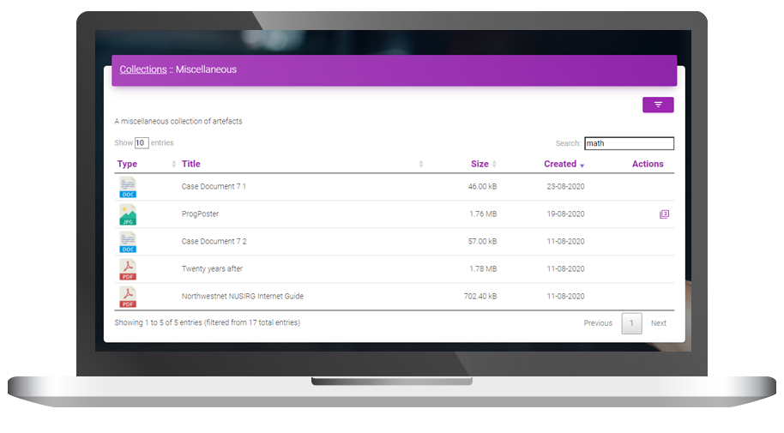
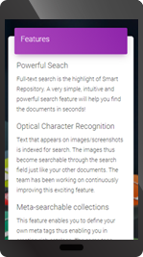

Slide 12
Who can
Benefit?
Virtually any organization can make use of this powerful tool.
Localization is supported so we can customize Smart Repository in the language of your choice.
Researchers, Educational institutes, Corporate offices, Law firms and many more. The possibilities are endless!

Slide 13
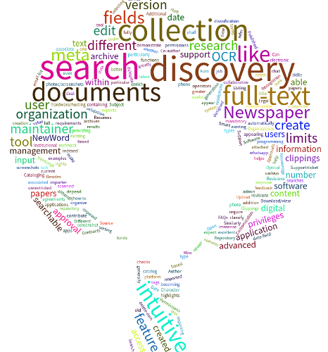
Thank you!
To request a demo or pricing information, contact
Email: info@carvingit.com
Phone: +91 94201 21704

